Slide 1
Basic Biological Concepts
Lecture 5 – Basic Biochemistry I
BIO 10 – Spring 2020

Slide 2
Membrane Chemistry
Barrier Chemistry
Transport Chemistry
2. pH in the Body
3. Energy Chemistry
Photosynthesis
Glycolysis
Oxidative Phosphorylation
Fermentation

Slide 3
Barrier Chemistry in the Plasma Membrane
Molecules can harm the cell but they also need to enter and leave the cell
This is the role of the plasma membrane because it is semi-permeable
“Permeability versus semi-permeability”
A permeable membrane is one that lets everything in/out
An impermeable membrane is one that does not let anything in/out (like a plastic bag)
A semi-permeable membrane is one that lets some things in/out but not all

Slide 4
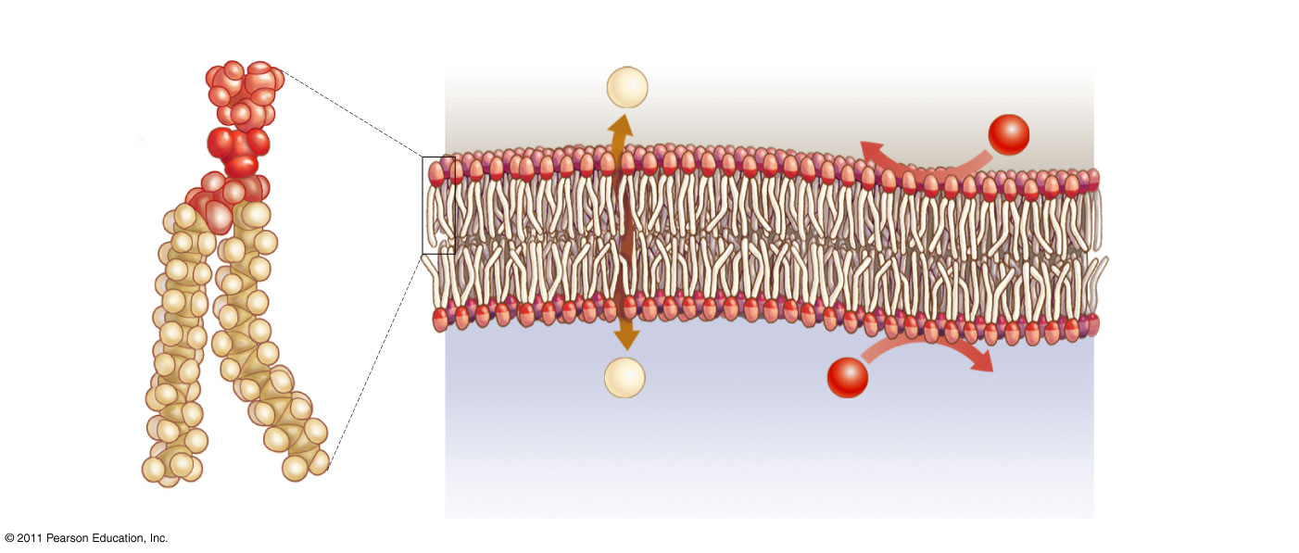
Phospholipid Bilayer is highly Selective
“Selects” which molecules pass through and which ones cannot!
Phospholipid
Phospholipid bilayer
watery
extracellular
fluid
polar
head
Several common, small molecules can slip through a membrane slowly:
H₂O
O₂
CO₂
Urea
hydrophilic
hydrophobic
non-polar
tails
hydrophilic
watery
cytosol
Non-polar molecule
Polar molecule
Non-polar molecules are rare in the aqueous body but can pass through membranes when they can reach them.
Most molecules in the body are polar and dissolve in water. They cannot pass the non-polar portion of membranes

Slide 5
The Special Case of Osmosis
Water molecules (although polar) move freely across the membrane (but slowly)
In the body, there are always many ions and polar molecules dissolved in the water
Water can cross but dissolved stuff cannot, so water will move to make the sides equal
Osmosis is the movement of water molecules from an area of lower solute concentration to higher solute concentration

Slide 6
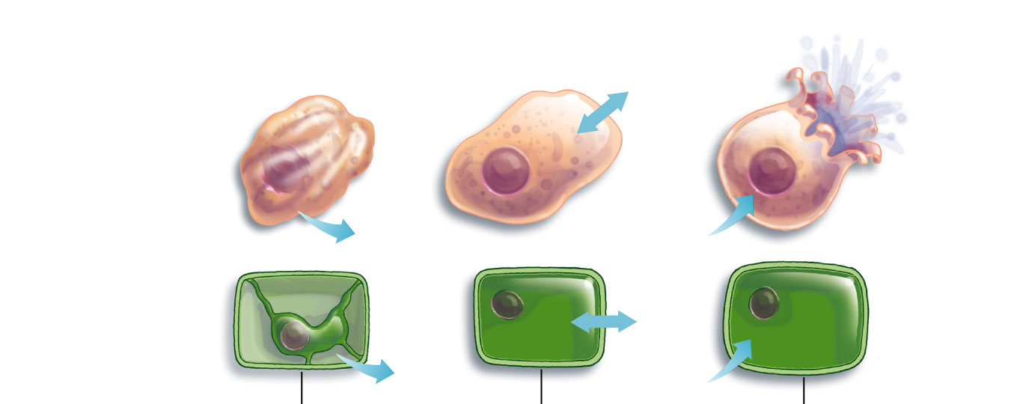
Cells will gain or lose water relative to their surroundings
H₂O
Animal cell:
plasma membrane
H₂O
H₂O
Plant cell:
H₂O
plasma membrane
cell wall
H₂O
H₂O
(a) Hypertonic surroundings
higher solute concentration outside the cell
(b) Isotonic surroundings
same concentration of solute outside as inside the cell
(c) Hypotonic surroundings
less solute concentration outside the cell
In the clinical setting you really have to be careful what you inject into the bloodstream!

Slide 7
We know we have to get sugars, amino acids, etc. into cell so How does the Plasma Membrane Regulate Transport?
There are two main types of transport across the membrane
Passive Transport – movement with the concentration gradient; no energy required
Simple diffusion
Facilitated diffusion
Active Transport – movement against the concentration gradient; requires energy (ATP)

Slide 8
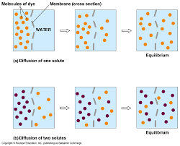
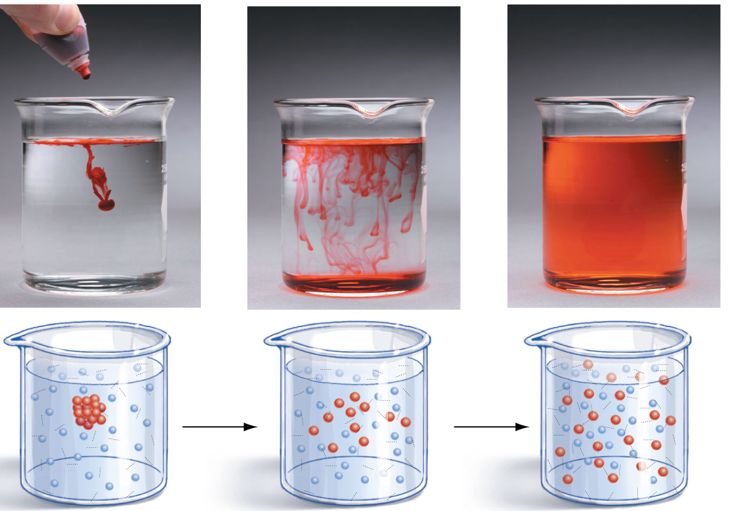
Diffusion – spontaneous movement of molecules from higher to lower concentrations (with the gradient)
Without a membrane
With a membrane

Slide 9
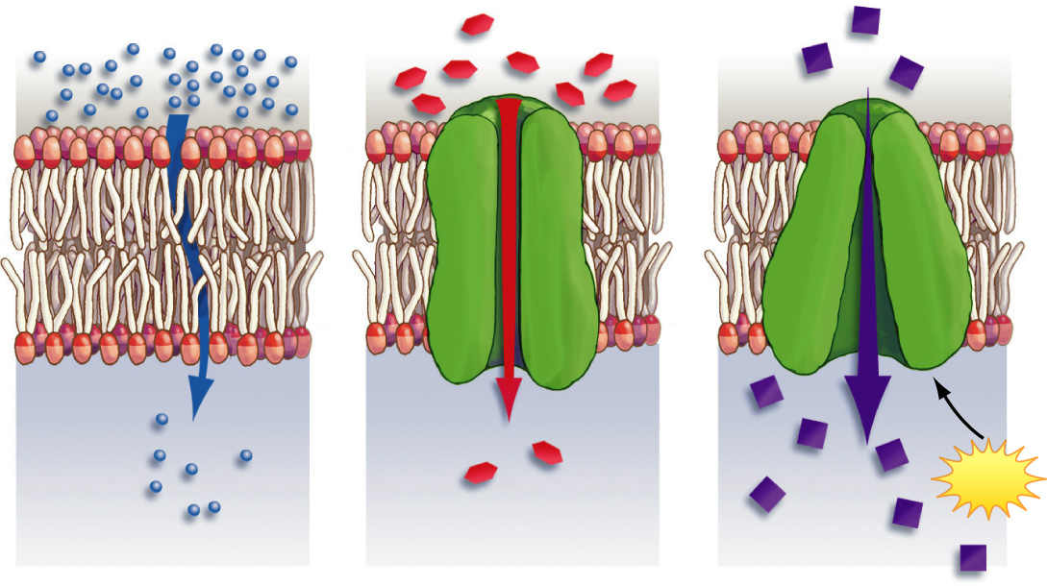
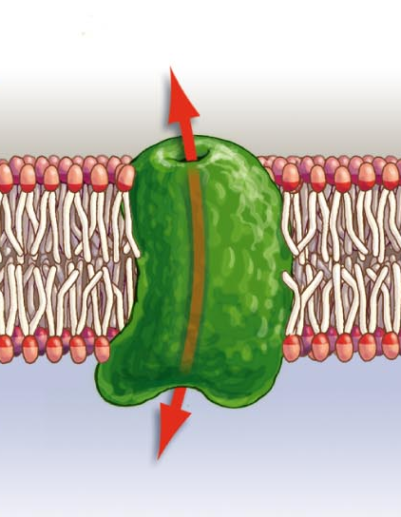
Passive Transport (no energy required)
(1) Simple Diffusion
Does not require membrane proteins
Materials move down (with) their concentration gradient through the phospholipid bilayer
Molecules are very small or non-polar
Water, gases, fat soluble molecules
(2) Facilitated Diffusion
Requires Transporter proteins (membrane proteins)
Large polar molecules, ions, sugars that need to be moved with the gradient
No energy required!

Slide 10
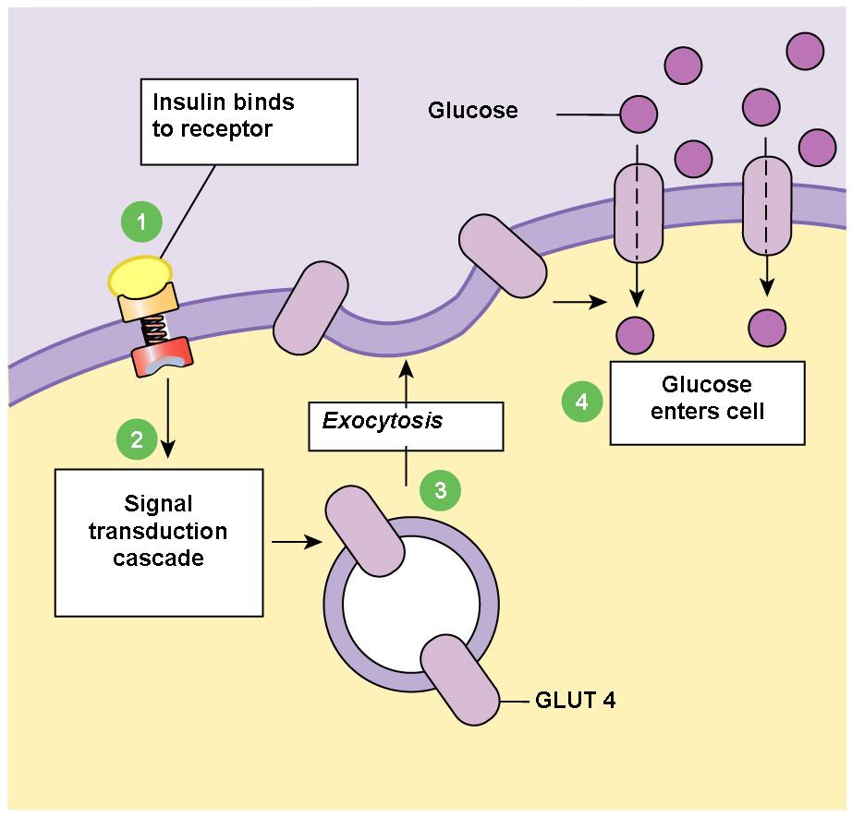
Example of Communication and Facilitated Diffusion functions of the Plasma Membrane
Insulin signals the transport of glucose inside the cell
Membranes fuse
Glucose transporter proteins bound to membrane of secretory vesicle (from Golgi app)

Slide 11
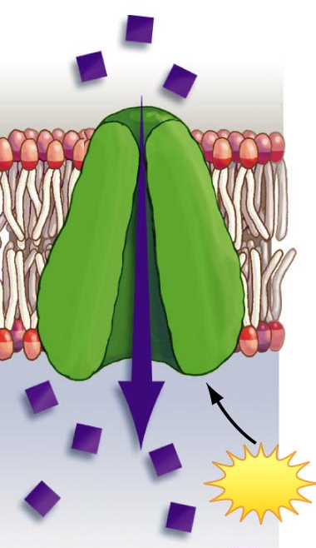
Active Transport (requires energy)
Requires Transporter proteins
Energy (ATP) is spent to move compounds against the concentration gradient
(from lower to higher concentration)
Any molecules, ions, sugars that need to be moved against the gradient
Molecules move through a transport protein, but now energy must be expended to move them against their concentration gradient
ATP

Slide 12
pH in the Body
All living things are sensitive to pH
Biological molecules do not operate properly if the pH is not held close to pH 7 (neutral)
This can quickly lead to death
Organisms control the pH in their cells (homeostasis)
pH inside human cells usually close to 7.4 (range 6-8)
The stomach pH is 1-4 to help break down food

Slide 13
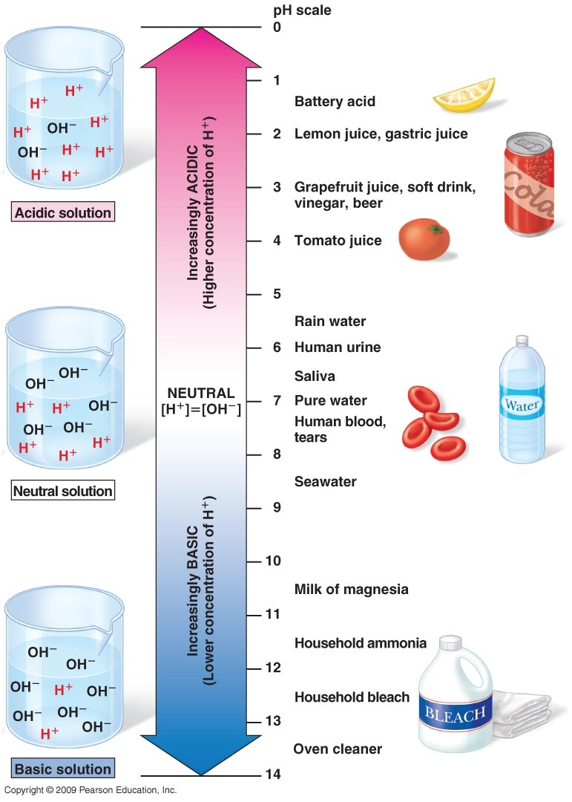
Notice the number of H⁺
What is pH?
pH = the concentration of H⁺ ions in an water (aqueous) solution
acid solution = low pH = high H⁺ conc.
basic solution = high pH = low H⁺ conc.
The pH scale
scale goes from 0 to 14
1 pH unit = 10-fold change in H⁺ ions
pH=7 has 10X more H+ than pH=8

Slide 14
Acids and Bases
Acids are substances that donate H+ when placed in water
Increases concentration of H+ in solution
Example:
HCl (hydrochloric acid)
breaks down into H+ and Cl- in water
Bases are substances that take H+ when placed in water
Decreases concentration of H+ in solution
Example:
NaOH (sodium hydroxide) breaks down into Na+ and OH- in water
OH- “traps” any free H+ to form water (H₂O)

Slide 15
Buffers are dissolved molecules that resist change in pH. Their component ions can donate H+ under basic conditions and take them up under acidic conditions. The amount of acid or base that can be added to a buffer before changing its pH is called its buffer capacity. Our bodies use the bicarbonate buffer system to maintain the pH of the blood, small intestine and other body fluids.

Slide 16
Energy Chemistry
Metabolism is the set of all chemical reactions taking place in an organism in order to maintain life
Metabolic reactions can be divided into 2 general types:
Anabolic – build up molecules
Catabolic – break down molecules

Slide 17
A catalyst is a molecule that helps chemical reactions occur
Catalysts are never used up in the reactions they take part in (they are neither reactants nor products)
An enzyme is a protein that catalyzes (speeds up) a chemical reaction
Nearly all chemical reactions that take place in living things are facilitated by enzymes
By convention, the names of enzymes end in “ase”
Examples: lactase, amylase, alcohol dehydrogenase

Slide 18
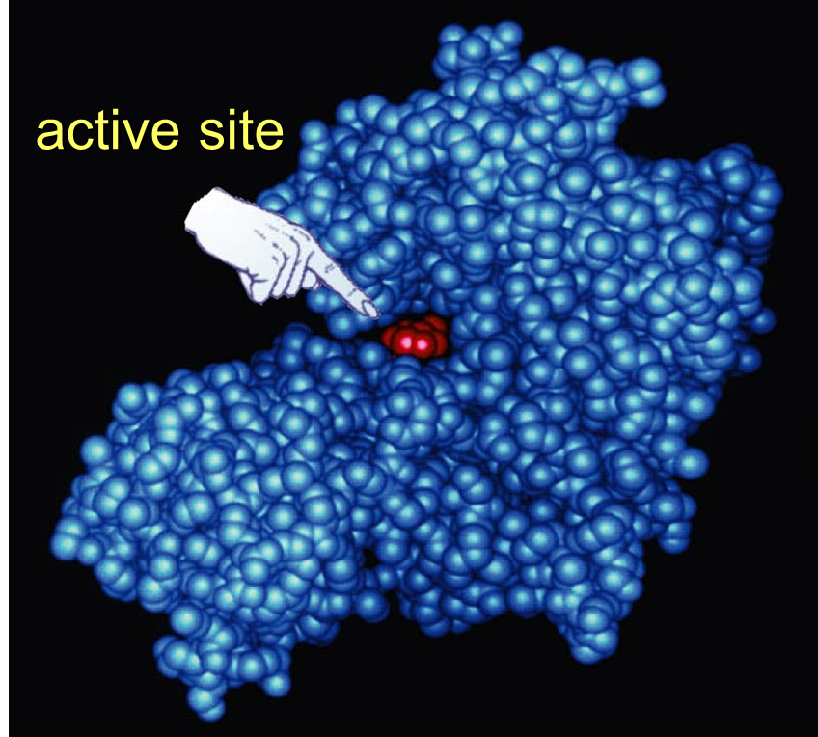
The molecules that an enzyme transforms is called its “substrate”
A substrate binds to an enzyme at a very specific region of the protein called the “active site”
The active site of an enzyme has the perfect 3-D shape for its substrate, which has a corresponding 3-D shape
An enzyme and its substrate fit together like a lock and key

Slide 19
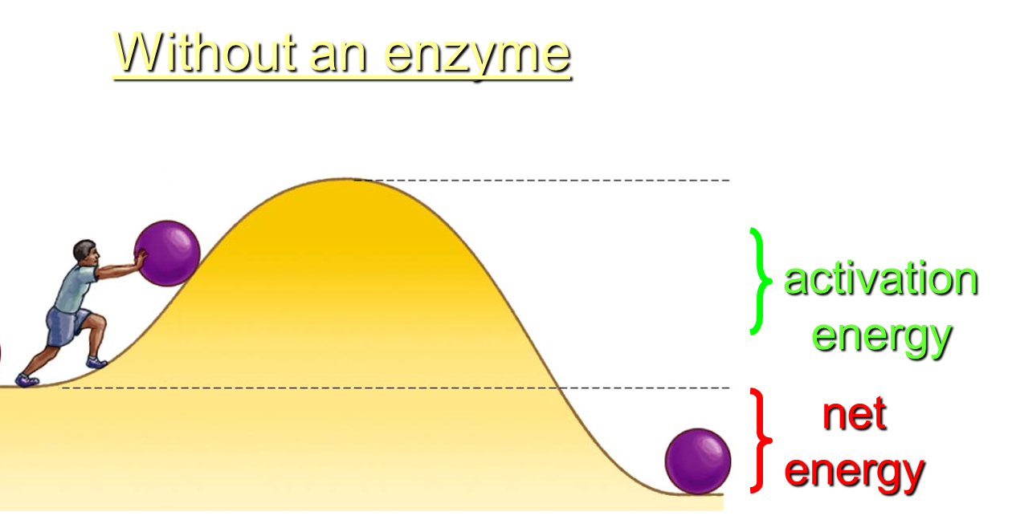
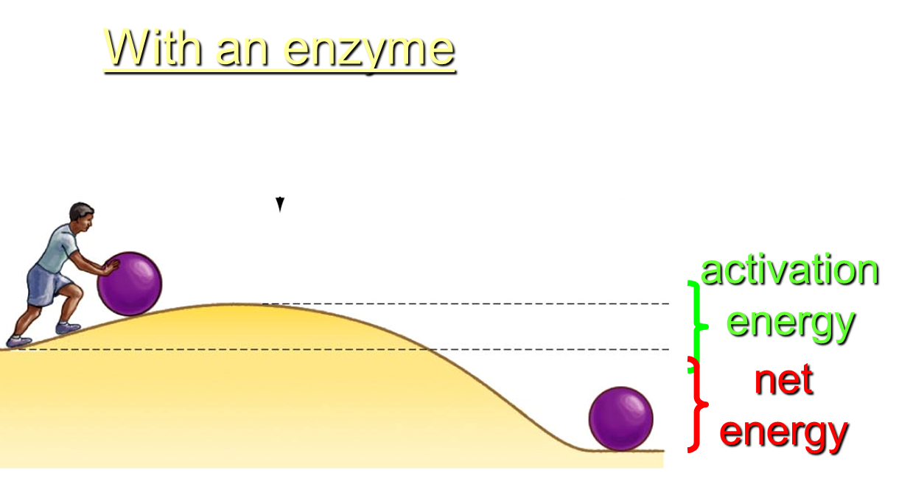
Enzymes are able to speed up reactions many thousands of times faster than normal because…
Enzymes lower the energy of activation of a chemical reaction

Slide 20
In some cases, substrate binding is facilitated by coenzymes: helper molecules other than proteins that facilitate the work of enzymes by binding with them.
Vitamins are often coenzymes
Vitamin deficiency results in enzyme failure
Why do you need so little of vitamins from food compared to how much energy you need from food?
Vitamins and enzymes are reusable.

Slide 21
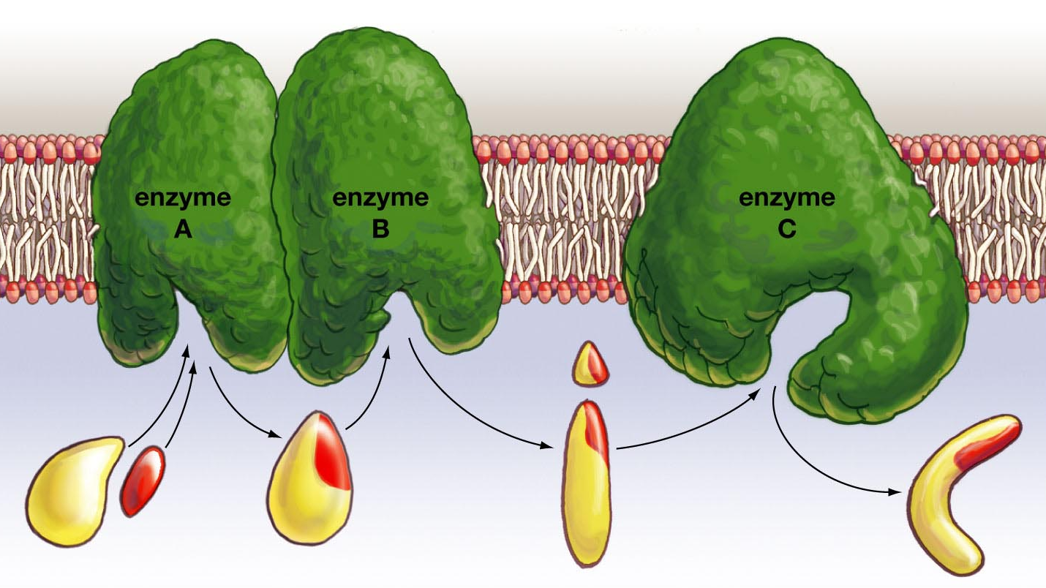
A metabolic pathway is when several enzyme work together to catalyze a multi-step reaction
It is more efficient if the enzymes are in close proximity
substrates
product

Slide 22
Enzyme regulation is accomplished by:
Changing the number of available enzymes (making more or removing existing enzymes)
Allosteric regulation – modifying the effectiveness of an enzyme by changing its shape with reactants

Slide 23
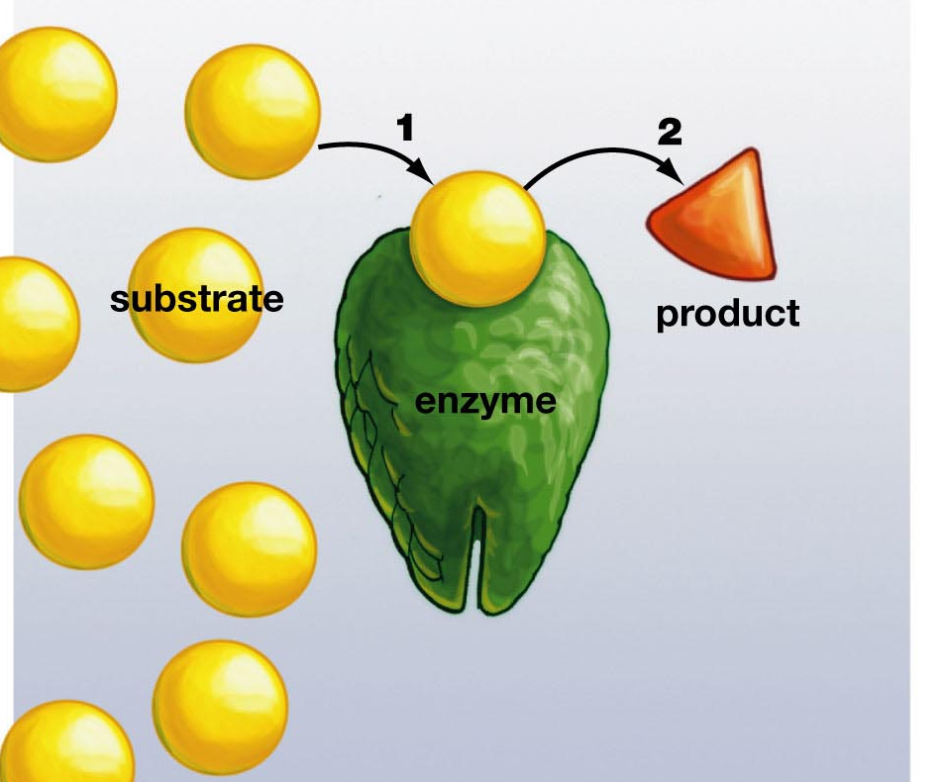
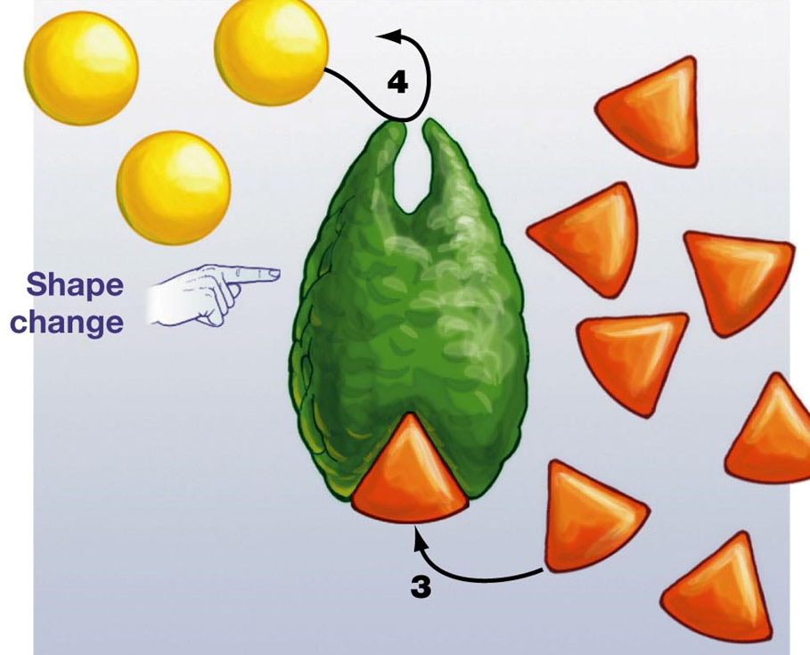
Allosteric regulation provides a means for negative feedback
The products of a catalyzed reaction can bind to the enzyme to change its shape and inhibit its action

Slide 24
Negative regulation of enzymes can occur
Both temperature and pH (measure of acidity) effect the shape of enzymes
If an enzyme’s shape changes, it can no longer function properly

Slide 25
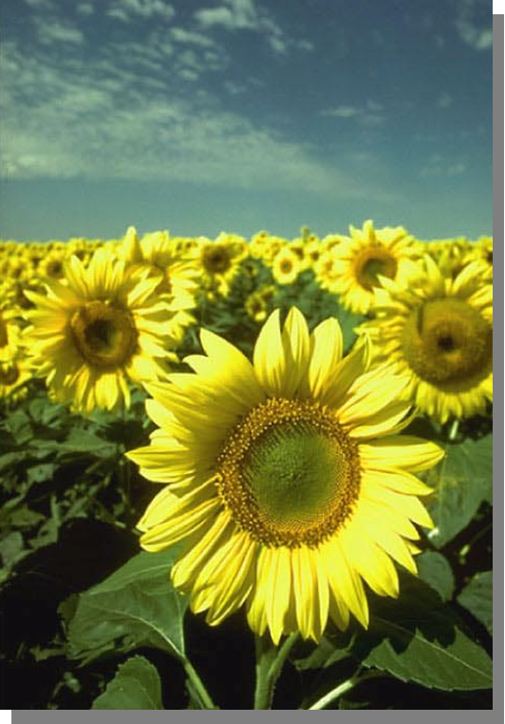
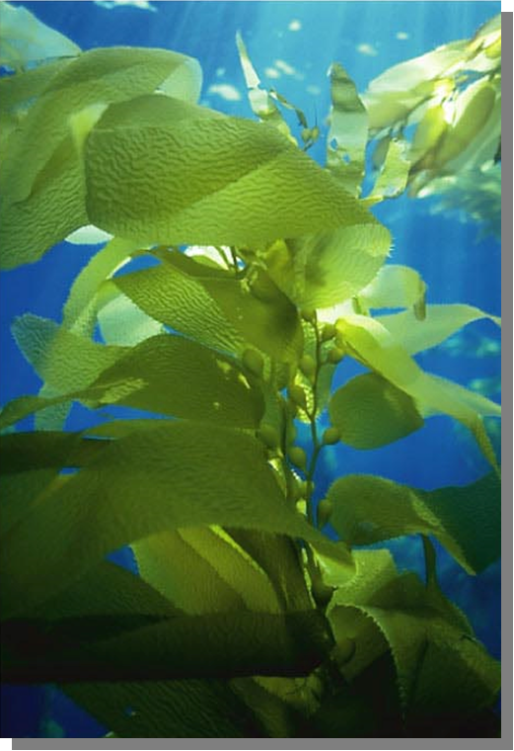
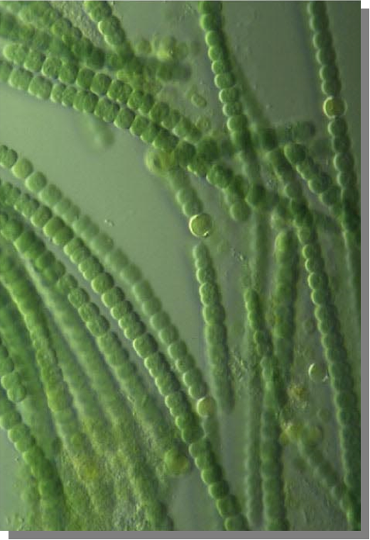
Photosynthesis is the process by which certain groups of organisms capture energy from sunlight and convert it into chemical energy (stored in the bonds of a sugar)
Three types of organisms have the capability to perform photosynthesis in order to make their own food…
Plants
Protists
(algae)
Cyano-
bacteria

Slide 26
Photosynthesis is vitally important to animals for several reasons…
1. It is the ultimate source of energy in all the food we eat
The energy captured by photosynthesis is about 6 times greater than the power consumption of human civilization
2. Its by-product is oxygen (O2) which we need to live
Every breath you take is courtesy of the photosynthetic organisms
3. It removes CO2 (a greenhouse gas) from the atmosphere
Photosynthetic organisms convert ~100 trillion tons of carbon to biomass per year

Slide 27
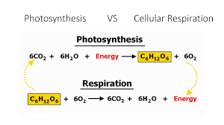
The process of photosynthesis is the opposite of cellular respiration
Photosynthesis makes sugar from CO₂ using solar energy
Cellular respiration breaks down sugar to CO₂ releasing chemical energy

Slide 28
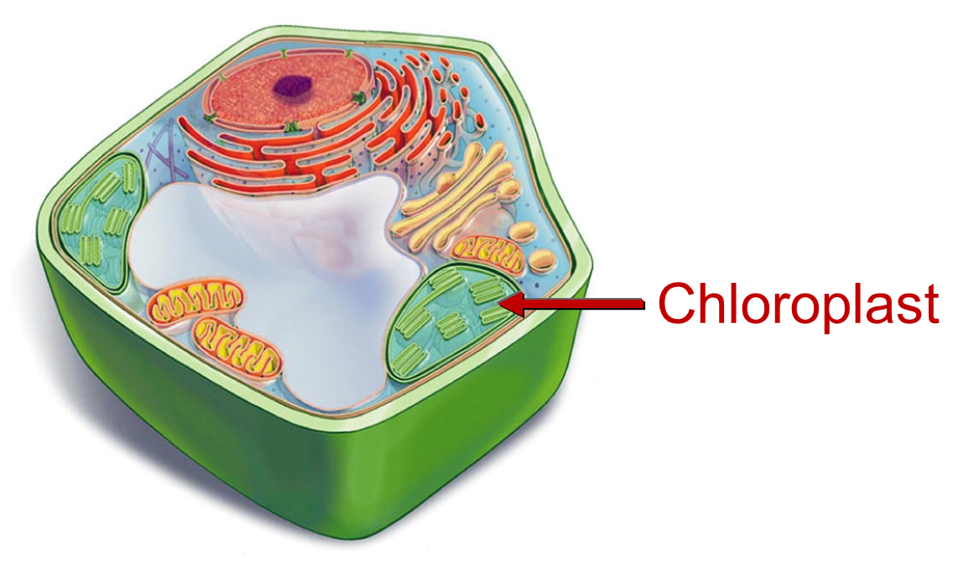
Chloroplasts:
Double-membrane organelles
Site of photosynthesis in plants
Photosynthesis occurs in two stages:
Light-dependent phase (a.k.a. Light-reactions phase)
Light-independent phase (a.k.a. Dark-reactions phase, the Calvin Cycle)

Slide 29
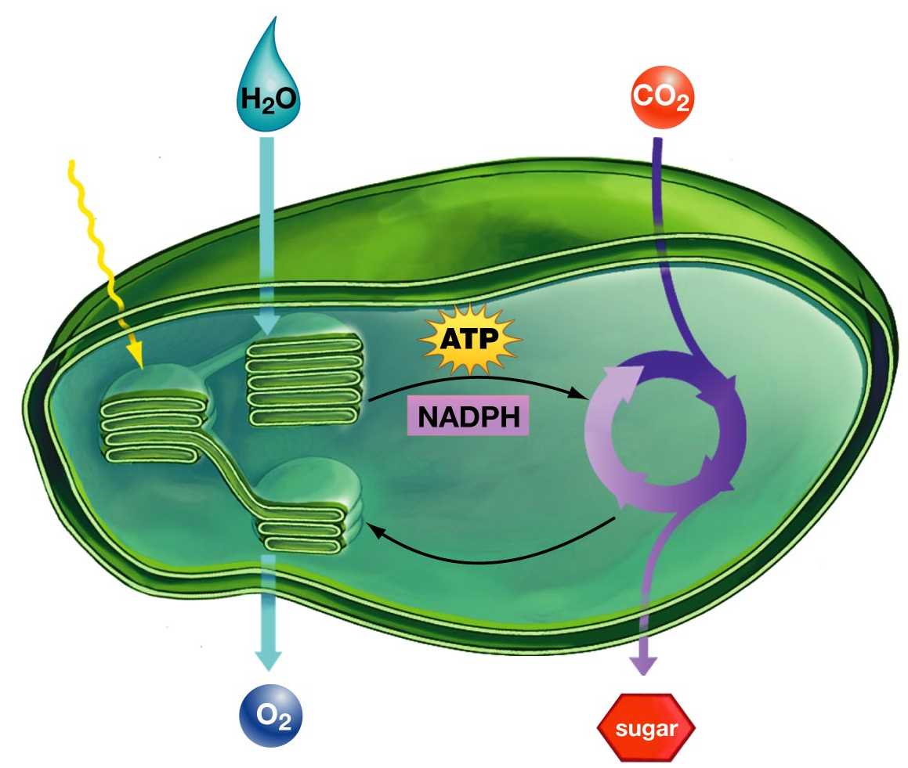
Light-dependent phase:
Uses sunlight to create the high energy molecules ATP and NADPH
Chlorophyll removes hydrogen from H₂O to create and release oxygen (O₂)
The Calvin Cycle:
Requires no sunlight
Uses the energy in ATP and NADPH to combine CO2 into sugar molecules
Sunlight
NADP⁺
ADP
Light-dependent
Calvin Cycle

Slide 30
A plant that makes sugar through the process of photosynthesis can then use the sugar to:
create ATP via cellular respiration
create starch to store the energy
create cellulose for its structure

